Slide 1
ARM 7 TDMI
Working with Data Memory

Slide 2
Objective
Objective of this presentation is to give a better understanding of working with Data Memory in Assembly Level coding.
To Have better understanding, we will use a simple program as mentioned below.
To find the 2’s Complement of a given 32 bit unsigned number stored in RAM Memory Location and to store the result in the next memory location.

Slide 3
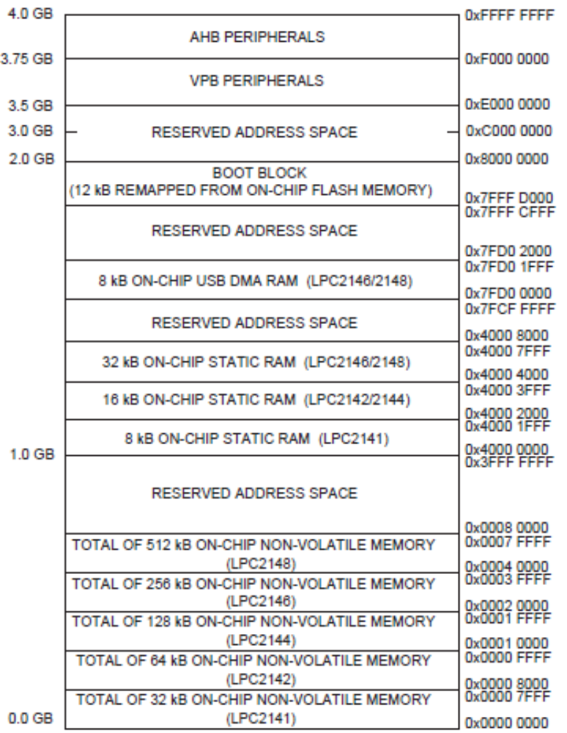
Memory Map – LPC2148
Data
RAM
(Data Memory)
Program
Flash ROM
(Code M/M)

Slide 4
;example
AREA Demo, CODE, READONLY
Main
LDR r0, =X1 ; Load the memory address of variable X1 into GPR R0
LDR r1, =X2 ; Load the memory address of variable X2 into GPR R1
LDR r2, [r0]
MVN r3, r2
ADD r4, r3, #1
STR r4, [r1]
MOV r5, r4
NOP
NOP
LOOP B LOOP
AREA Data, DATA
X1 DCD &FFFFFFF6
X2 DCD &40000000
END

Slide 5
Hints
NOTE: For ARM Instruction set, refer the book “ARM: Assembly Language Programming by Stephen Welsh” available in te following OneDrive Link.
https://amritavishwavidyapeetham-my.sharepoint.com/:b:/g/personal/v_ananthanarayanan_cb_amrita_edu/Ed25I8rka05HueLXOppM_R4B9sz0xwqcjmQAfFxiZyIxGA?e=oEshQb

Slide 6
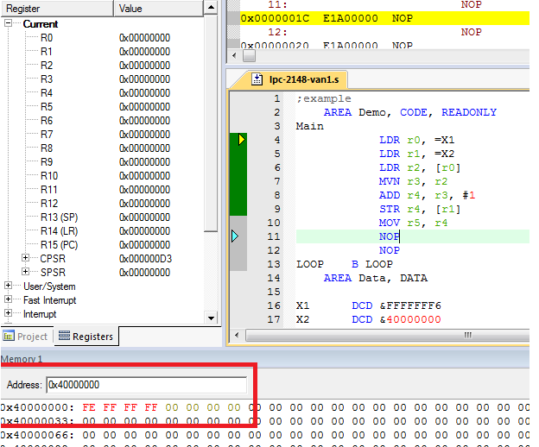
Procedure to View Data Memory and Enter User Data in the respective memory location.
After compiling, enter into debug mode, select Memory window and enter the Range 0x40000000 in the text box under Memory.

Slide 7
By double clicking the respective, memory location, we can enter data.
By the above way, we enter the 32 bit number 0xFFFFFFFE for which 2’s complement has to be generated.
Little Endian: LSB FIRST ( Least Significant 8 bits of 32 bit number will occupy the Lowest address. Here LSB 8 Bits FE will occupy the address 0x40000000
Location: 0x40000000 Data: 0xFFFFFFFE
Address | Data | Position
0x40000000 | FE | LSB
0x40000001 | FF
0x40000002 | FF
0x40000003 | FF | MSB

Slide 8
SIMULATION

Slide 9
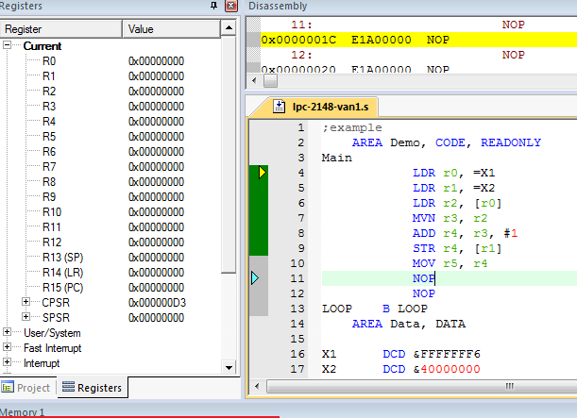
Step 0 : First Look in the Debug Session
Note PC = 0x00000000 and all GPRs are 0x00000000.

Slide 10
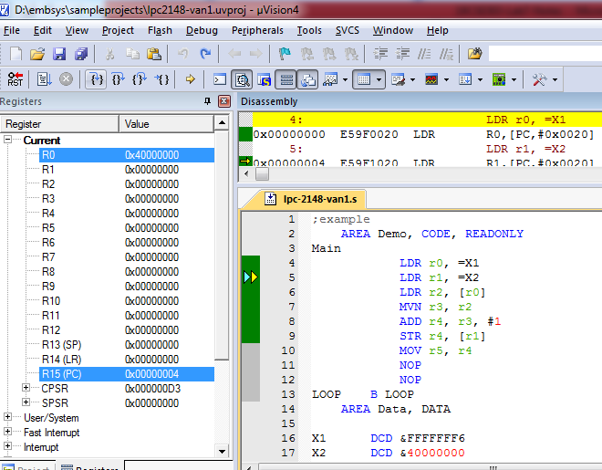
Step 1 : After the execution of First Instruction
After executing the first instruction (LDR r0, =X1), PC becomes 0x00000004 and R0 = 0x40000000 ( RAM memory address where data X1 was stored.)

Slide 11
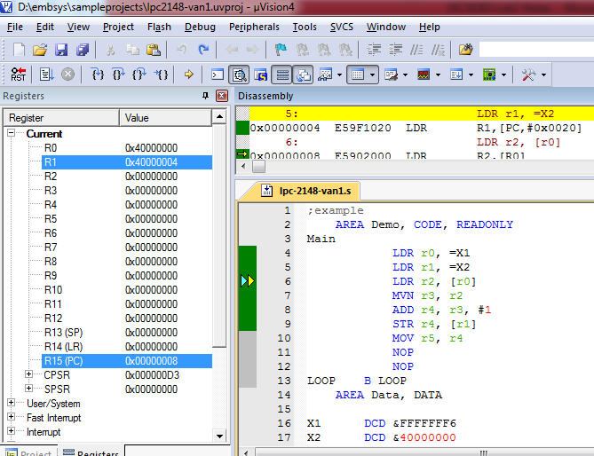
Step 2 : After the execution of Second Instruction
After executing the second instruction, ( LDR r1, =X1), PC becomes 0x00000008 and R1 = 0x40000004 ( RAM memory address where data X2 has to be stored.)

Slide 12
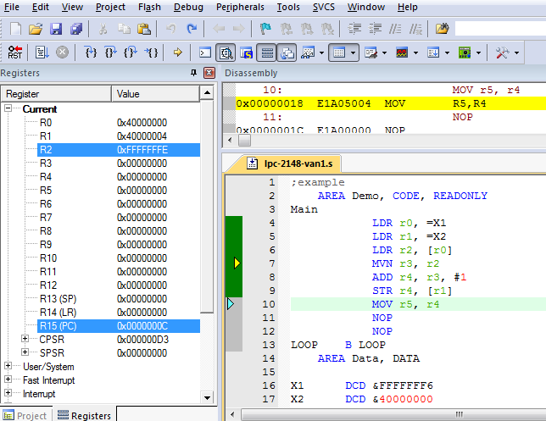
Step 3 : After the execution of Third Instruction
After executing the third instruction, ( LDR r2, [r0] ), PC becomes 0x0000000C and R2 = 0xFFFFFFFE ( Value of X1 = 0xFFFFFFFE in Memory location 0x40000000)

Slide 13
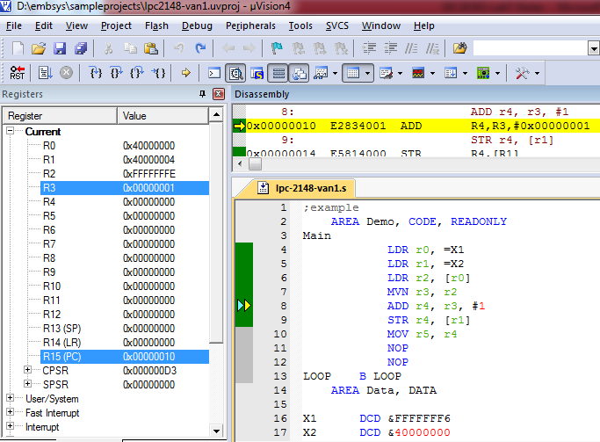
Step 4 : After the execution of Fourth Instruction
After the execution of fourth instruction ( MVN r3, r2), the value 0x00000001 (i.e) one’s complement of 0xFFFFFFFE is moved into R3. PC is now at 0x00000010

Slide 14
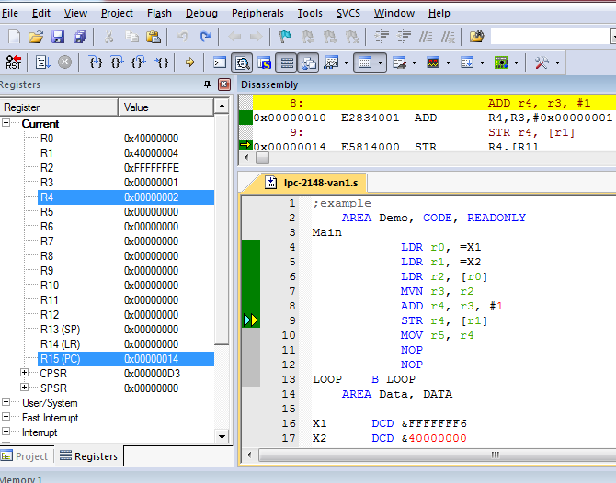
Step 5 : After the execution of Fifth Instruction
After the execution of fifth instruction ( ADD r4, r3, #1 ), the value 0x00000002 (i.e) two’s complement of 0xFFFFFFFE was moved into GPR R4 ) . PC is now at 0x00000014

Slide 15
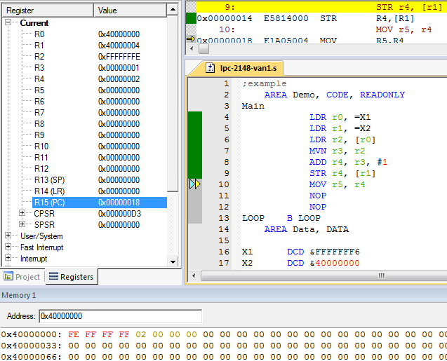
Step 6 : After the execution of Sixth Instruction
After the execution of sixth instruction ( STR r4, [r1] ), the value of R4 = 0x00000002 (i.e) two’s complement of 0xFFFFFFFE) will be stored into 0x40000004 ( This address is provided by Reg R1) . PC is now at 0x00000018

Slide 16
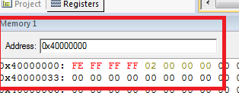
Seventh and Eighth Instruction are NOP ( Just for your understanding how PC gets increased by 4 after the fetch of every instruction ( 32 bits).
Last Instructions
Loop B Loop
keeps the controller to remain in the same state.

Slide 17
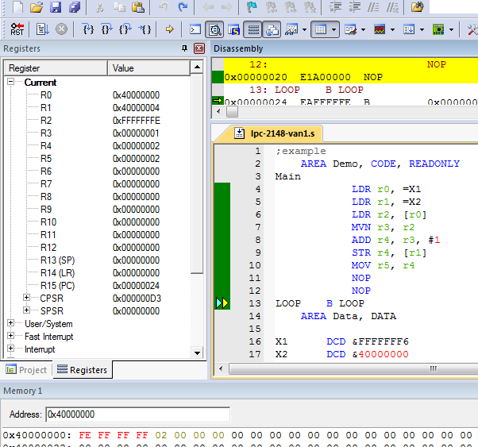

Slide 18
Code Memory Address | Instruction
0x00000000 | LDR r0, =X1
0x00000004 | LDR r1, =X2
0x00000008 | LDR r2, [r0]
0x0000000C | ADD r4, r3, #1
0x00000010 | MVN r3, r2
0x00000014 | MOV r5, r4
0x00000018 | STR r4, [r1]
0x0000001C | NOP
0x00000020 | NOP
0x00000024 | LOOP B LOOP
Note the value of PC PC = 0x00000024

Slide 19
End of Session

